Slide 1
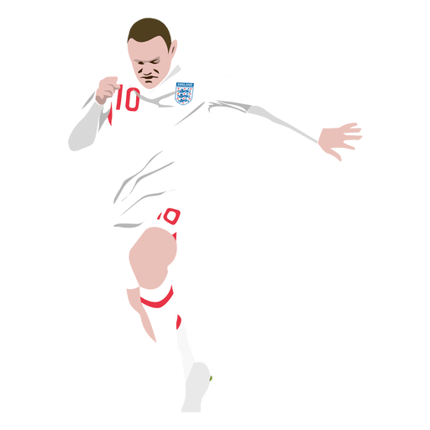
SOCCER: BEST GOAL SCORER PREDICTION
TENZING WANGDU

Slide 2
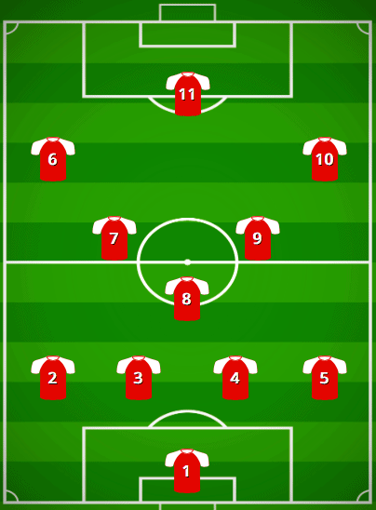
DATA & CLEANING
FILTERING VARIABLES
DATASET
NULL VALUES
Kaggle was used to get the dataset
Removed all the null values
Data cleaning by position of the players that generally score most of the goals

Slide 3
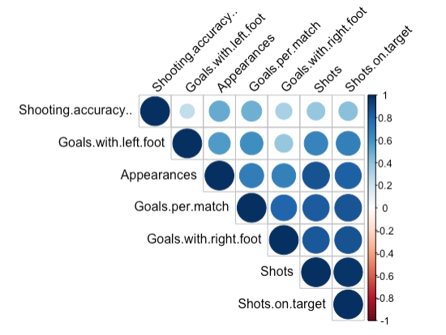
Correlation Matrix

Slide 4
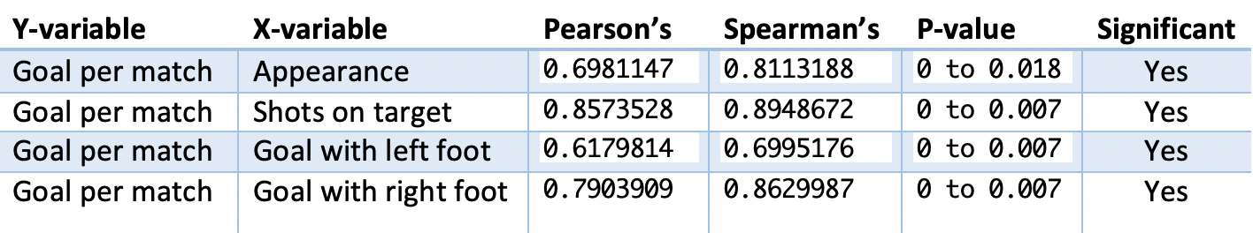
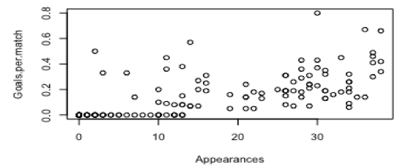
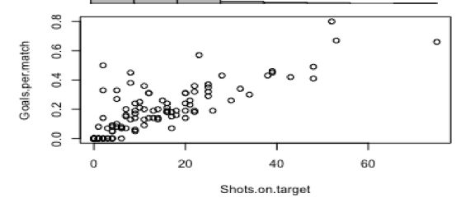
Association Analysis

Slide 5
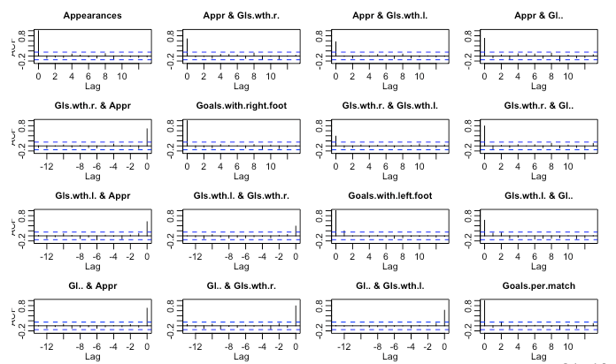
Auto-Correlation

Slide 6
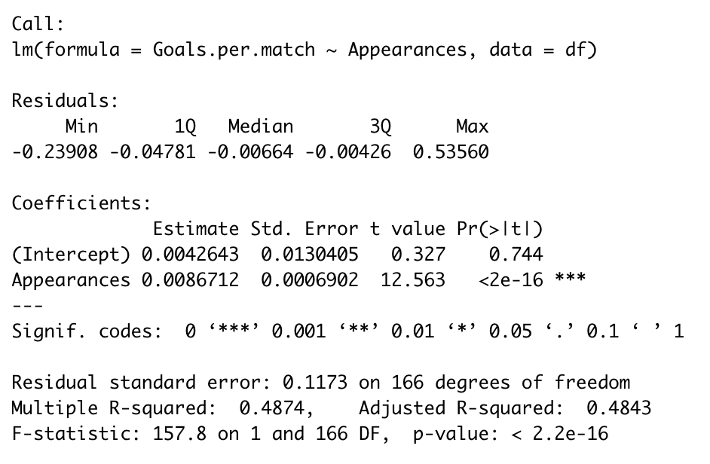
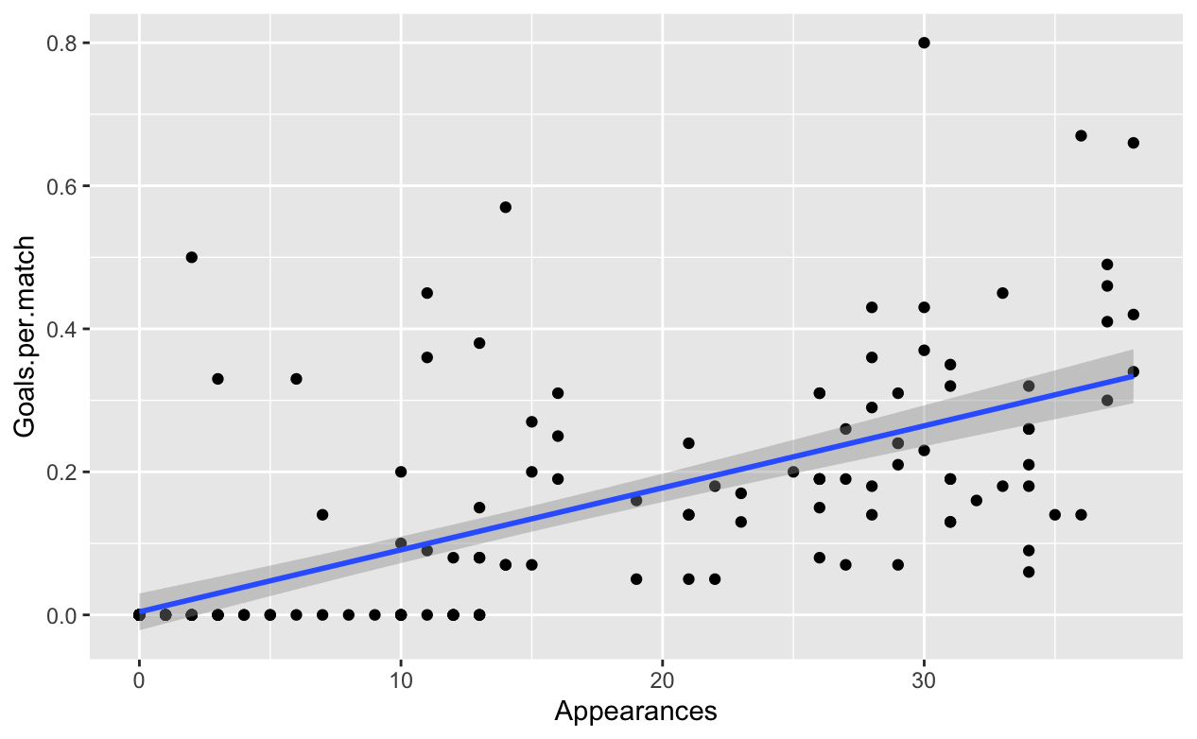
SIMPLE LINEAR REGRESSION
GPM= 0.004264 + 0.008671 * A

Slide 7
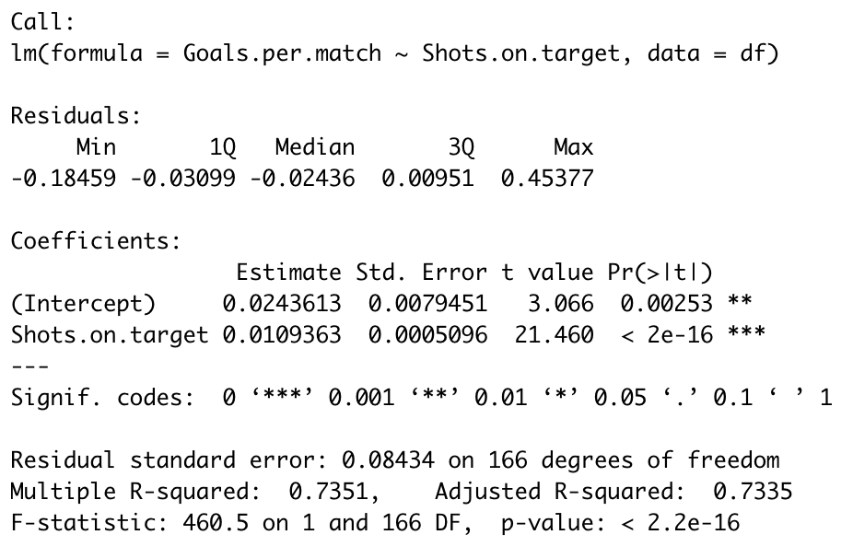
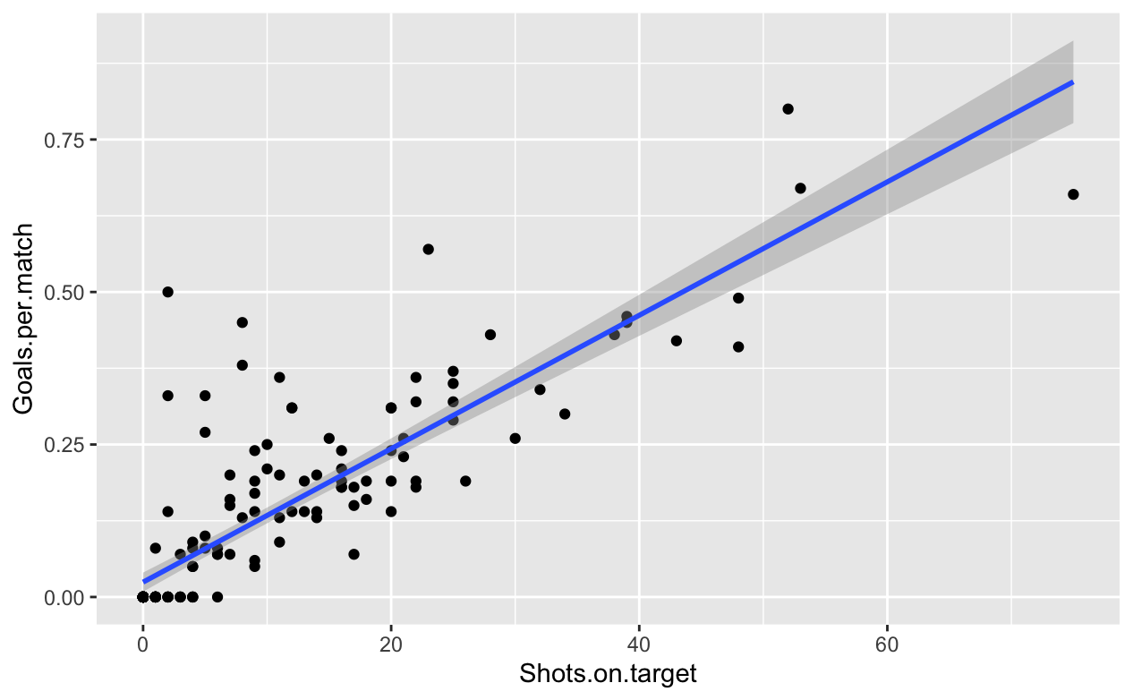
GPM= 0.0243613 + 0.0109363 * ST

Slide 8

Thank You

